Slide 1

Corporate Strategy Analysis Report
Macy’s Inc.
Robert Mepham, Aaron Bates, Jailin Scruggs, Celeste Acosta

Slide 2
Recommendations
What We’re Going To Recommend
Modernize The Brick & Mortar Business Model
Modernize Our Marketing & Brand Image
Partner with Boutique Brands
Shift Business Model To ‘Online First’
How We’re Going To Get There:
Introduce An Issue
Provide Relevant Analysis
Connect Back To Recommendation
Reiterate Competitive Advantage & Strategy

Slide 3
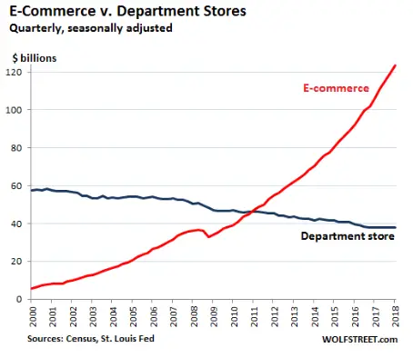
Issue #1: Brick & Mortar Business Model Is Dying
Internal Analysis:
Macy’s Can’t Continue As a Primarily B&M Business
Management Needs To Adapt Their Priorities Accordingly
Source: https://www.businessinsider.com/brick-and-mortar-retailers-getting-hit-the-hardest-2018-5

Slide 4




Snapshot of Internal Operations
Sell Anything From Clothes, Accessories, Houseware, Jewelry, Perfume, etc.
Operates 1574 Locations, With Footprints In Over 90 Countries
Corporate Umbrella
As of Aug. ‘22

Slide 5

Before We Hop Into External Analysis…
Who Are Our Competitors?
What Is Our Competitive Position?

Slide 6
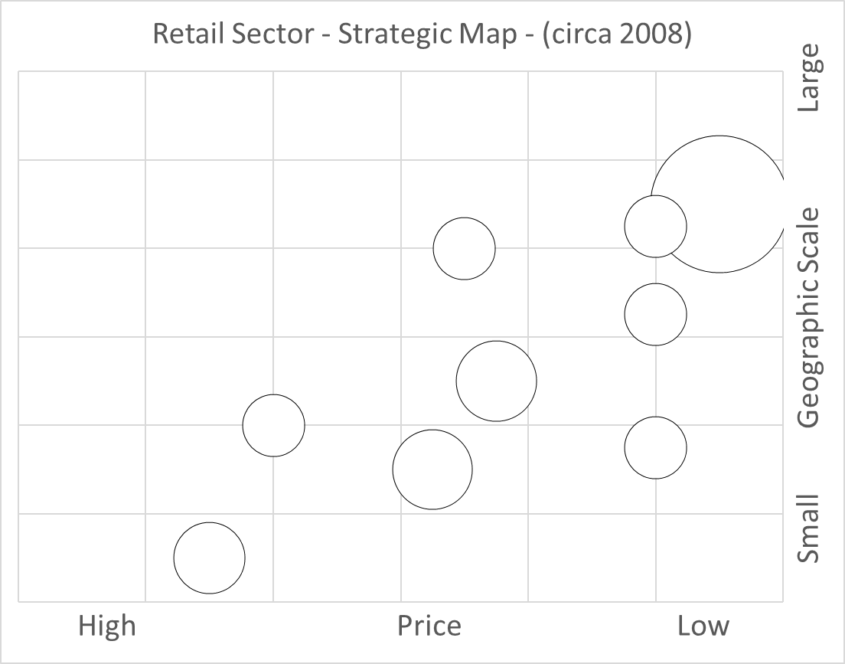
Peer Group:
Macy’s
JC Penney
Nordstrom
Kohl’s
TJ Maxx
Strategy:
Best Cost
Walmart
Sears
Target
TJ Maxx
Nordstrom
Kohl’s
Saks Fifth Avenue
JC Penny’s
Macy’s
Source: https://mba-lectures.com/management/strategic-management/1006/strategic-group-mapping-of-retail-chains.html

Slide 7
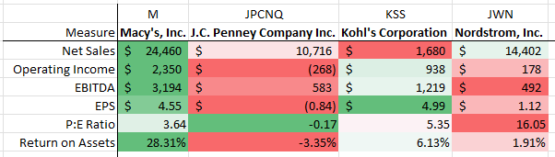
Financial Analysis
Macy’s Is In The Best Financial Position Out of Any of Its Competitors
JCPNQ Is No Longer Listed On The NYSE -> It Went To The Pink Sheets!
-0.17
Source: 2021-22 Annual SEC Filings: 10K Forms
Source: https://www.marketbeat.com/stocks/NYSE/JCP/#:~:text=About%20J%20C%20Penney%20(NYSE%3AJCP)%20Stock

Slide 8
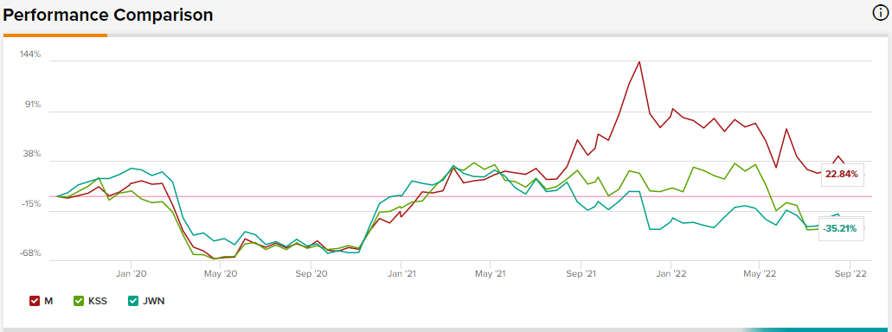
Stock Performance Comparison
Source: https://www.tipranks.com/compare-stocks/custom?ticker=M&ticker=KSS&ticker=JWN

Slide 9
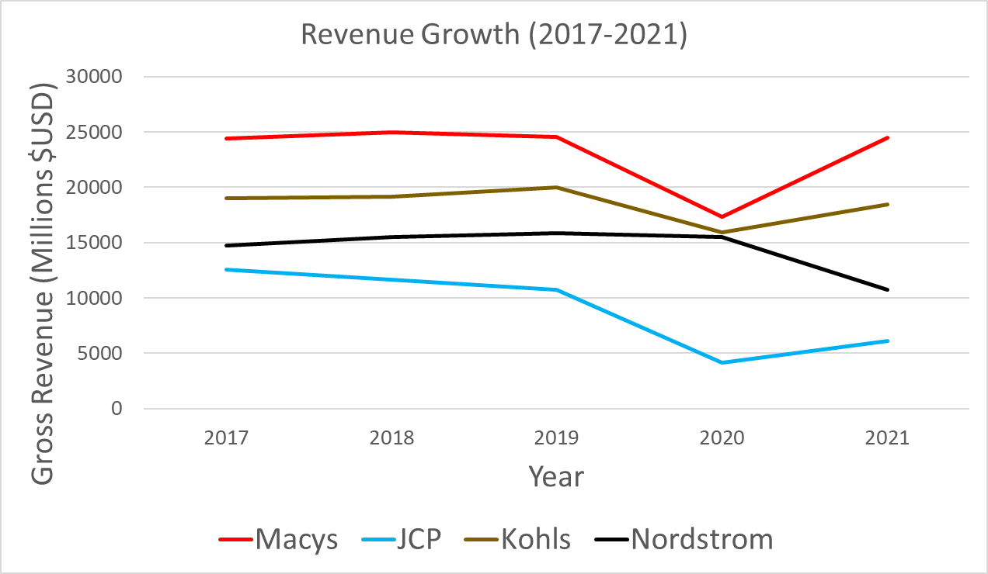
Bankruptcy
Source: 2017-22 Annual SEC Filings: 10K Forms

Slide 10
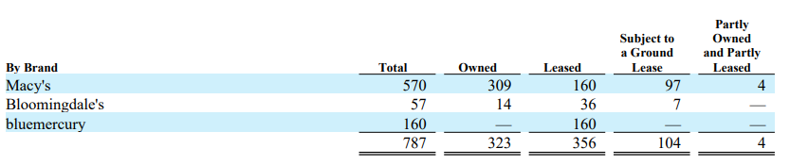
Are Our Resources Valuable?
Brick & Mortar Locations
Valuable - Yes
Rare - Yes
Inimitable - Yes
Nonsubstitutable - No
Result: Non-Sustainable Advantage
Inventory
Valuable - Yes
Rare - No
Inimitable - No
Nonsubstitutable - No
Result: Competitive Parity
Issue: We are seeing record back stock in inventory (failing supply chain)
Source: https://www.thestreet.com/investing/kohls-target-walmart-nordstrom-macys-overstock-inventory

Slide 11
SWOT Analysis
Strengths & Weaknesses
Strengths
Brand Recognition
Large B&M Footprint
Powerful Financial Position
Weaknesses
Promotion / Online Presence
Declining Quality of Service
Failed International B&M Expansion
Opportunities & Threats
Opportunities
New Brand Partnerships
Global Online Expansion
Threats
Death of America’s Shopping Mall
Strong Traditional Competitors
Online Competitors
Recession
Source: shorturl.at/ASUZ5
Source: shorturl.at/GJNQU

Slide 12
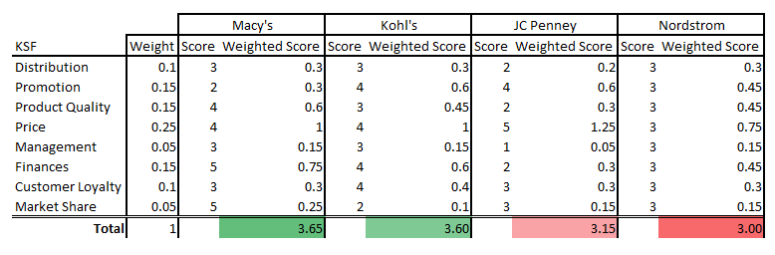
Competitive Strength Table

Slide 13
How Is The Macro Environment Looking?
P - Ukraine Conflict -> Cut off e-commerce presence in Russia
E - Inflation -> Has Caused Our Cost Position To Rise Substantially
S - BLM Movement -> Companies Becoming More Politically Vocal
T - E-Commerce -> Social Selling
E - Supreme Court EPA Ruling -> Changed Outlook on Net-Zero Projects
L - Minimum Wage Increases -> Both Warehousing & B&M Cost of Operations

Slide 14
So What’s The Solution?
Objective: Increase Utility of Our B&M Locations
Exclusive Partnerships w/ Online Only Brands
E.G. -> GymShark
Make B&M Shopping More Accessible To Younger Generation
Pursue An Exclusive Buy-Now Pay-Later Partnership
Partner w/ Heavy Foot-Traffic Sub-Sectors
E.G. -> Toys R’ Us

Slide 15
Issue #2: Outdated Brand Image
“to operate Macy's and Bloomingdale's as dynamic national brands while focusing on the customer offering in each store location.”
Dynamic National Brands
Focusing On Customer Offering
Vision:
Mission:
“to be a retailer with the ability to see opportunity on the horizon and have a clear path for capitalizing on it. To do so, we are moving faster than ever before, employing more technology and concentrating our resources on those elements most important to our core customers.”
Moving Faster
More Technology
Core Customers
Source: https://mission-statement.com/macys/#:~:text=Macy's%20vision%20statement%20is%20%E2%80%9Cto,the%20brand%0of%20the%20company.

Slide 16

Who Are Our Core Customers?
Age: 16 - 35
Gender: Female
Income: Middle Class

Slide 17
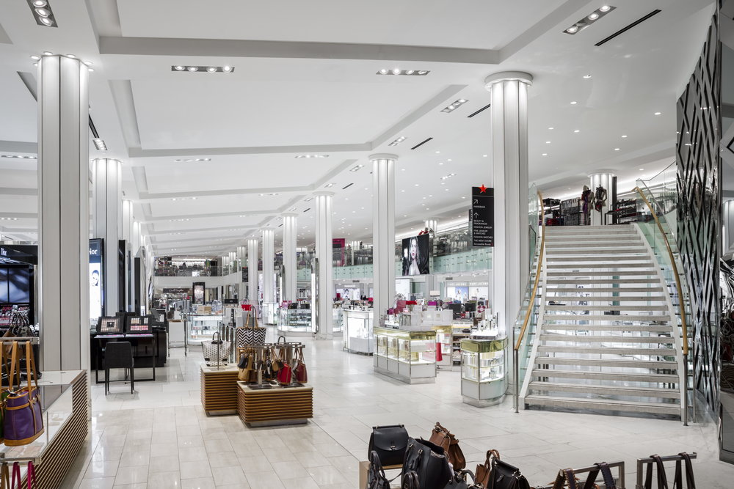



Are 16-35 Year Old Middle Class Women In Our Stores?
What We Have
What They Want
Source: https://www.buzzfeed.com/jessicamisener/30-flirty-and-surviving

Slide 18
Ok, So How Do We Get There?
Modernize Our Marketing Strategy
Meet The Customer Where They Are
Don’t Rely On Foot Traffic
Update Our Brand Image
Socially Conscious Branding
Chose New Sub-Peer Group Of “Trendy” Companies
Benchmarking
Competitive Strength Table
Value Chain -> Marketing

Slide 19

Issue #3: Aging Demographic
Target Demo: 16-35 y/o, Female, Middle Class
Breaks Down Into Two Groups
16 - 25 y/o Group
25 - 35 y/o Group
In 5/10 Years, Who Are Those 25-35 Females?
Gen Z
Money

Slide 20

Market Share Among Gen-Z
For Over 70% Of Gen-Z, Macy’s = Christmas
Increasing Seasonality of Demand Increases Risk
Source: https://partner.studentbeans.com/blog/retail-insights/gen-z-retail-department-stores/

Slide 21
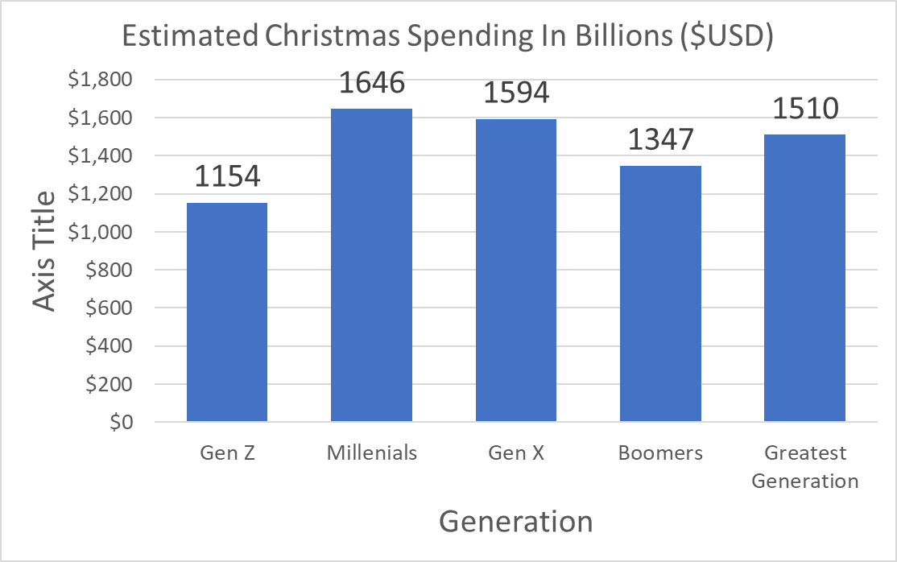
Why Is That A Problem?
Billions $USD
Source: https://influencermarketinghub.com/gen-z-spending-habits-stats/

Slide 22
So How Can We Pivot To Appeal To Gen Z?
Macy’s Value Chain (Simplified)
Supply Chain
Warehousing
Sales
Primary
Inbound Logistics
Storage & Distribution
~78% Of Sales Are From Non-Store Brands
To Carry 200+ Brands Per Store, Macy’s Has One of the Largest Warehousing & DC Operations Among All Department Stores
Direct To Consumer Sales
Macy’s Is Seeing Record Inventory Buildup in 2022
Brick & Mortar (Foot Traffic)
E-Commerce
Support Activities:
Procurement
Marketing
Technological Development

Slide 23



Change Up The Exclusive Procurement Mix
From This…

Slide 24




Change Up The Exclusive Procurement Mix
To This…

Slide 25
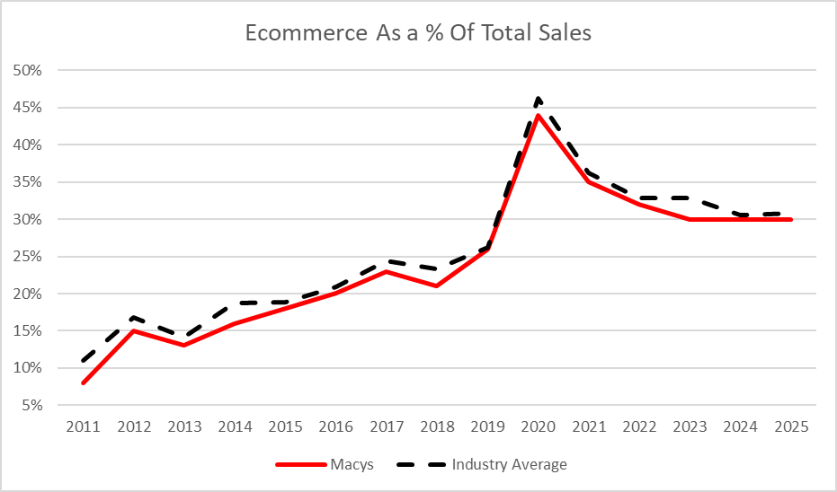
Issue #4: Lack Of Purposeful Online Presence
What is the Future of Retail?
Is it Brick & Mortar?
Is it Online?
Source: shorturl.at/gjnrU

Slide 26
Porter’s 5 Force Analysis – Threat of New Entrants
Economies of Scale In Production, Distribution, Advertising, Etc.
Incumbents Have Hard To Replicate Learning Curve & Cost Advantages
Customers Have Strong Brand Preferences and High Brand Loyalty
Patents and Intellectual Property Protections
Strong “Network Effects” In Customer Demand
Yes
No
No
No
No

Slide 27
Porter’s 5 Force Analysis – Threat of New Entrants (cont.)
High Capital Requirements
Difficulties in Building a Network of Distributors/Dealers or In Securing Self Space
Restrictive Regulatory And Trade Policies
Yes
Yes
No

Slide 28
Porter’s 5 Forces Analysis – Strength of Current Rivalry
Slow Growth And Declining Buyer Demand?
Customers Have Less Costly Switching Costs?
Products Are Not Differentiated?
Excess Inventory, Idle Production Capacity, Or Products w/ High, Fixed Storage Costs?
Rivals Are Numerous Or Equal In Size And Capability
Rivals Are Diverse
Exit Barriers Are High
Yes
Yes
Yes
Yes
Yes
No
Yes

Slide 29
Porter’s 5 Forces Analysis – Power of Buyers
Buyer Demand Is Weak In Relation To The Available Supply?
Industry’s Products Are Undifferentiated / Standard
Few Switching Costs
Available Substitutes
Buyers are A Credible Threat of Backward Integration
No
Yes
Yes
Yes
No

Slide 30
Porter’s 5 Forces Analysis – Power of Buyers (cont.)
Buyers are Knowledgeable of Products, Costs, and Pricing
Buyers Have Discretion in Delaying Purchases
Buyers Are Price Sensitive
Significant Fraction of Buyer’s Costs
Buyers Have Low Earnings
Is Price The Primary Concern?
No
Yes
Yes

Slide 31
Porter’s 5 Forces Analysis – Power of Suppliers
NOT a Strong Demand For Supplier Products & Availability of Products
Supplier Products are NOT Differentiated
Industry Members DO NOT have high costs for switching among suppliers
Size and number of suppliers relative to industry is great
No
No
Yes
Yes

Slide 32
Porter’s 5 Forces Analysis – Power of Suppliers (cont.)
No Credible Threat of Forward Integration
Cost of Suppliers’ Product Relative to the total cost of the industry’s product is NOT high
Availability of substitutes for supplier product
Industry members are major customers
Yes
No
Yes
Yes / No

Slide 33
Porter’s 5 Forces Analysis – Threat of Substitutes
Readily Available & Attractively Priced?
Comparable or Better In Terms of Quality, Performance, and Other Attributes?
Offer Lower Switching Costs To Buyers?
Yes
Yes
Yes

Slide 34

Porter’s 5 Forces - Summary
Threat Of New Entrants
Weak -> Traditional B&M Retail Isn’t Attractive in ‘22
Power of Current Rivalry
Fierce -> Slow Growing Industry
Power of Suppliers
Weak / Moderate -> Depending on SKUs that Macy’s Carries
Power of Buyers
Weak -> Direct to Consumer
Threat of Substitutes
High

Slide 35
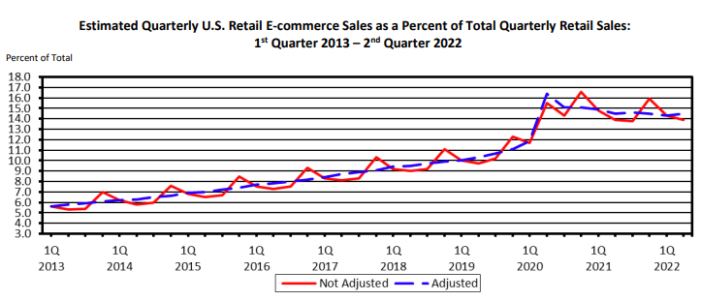
New-Aged Substitutes to Macy’s
Source: US Census Bureau
E-Commerce Has Grown From 6% of US Sales to ~16% In The Past Decade
New-Look Competitor
No B&M Presence
Lower Cost, Same Product

Slide 36
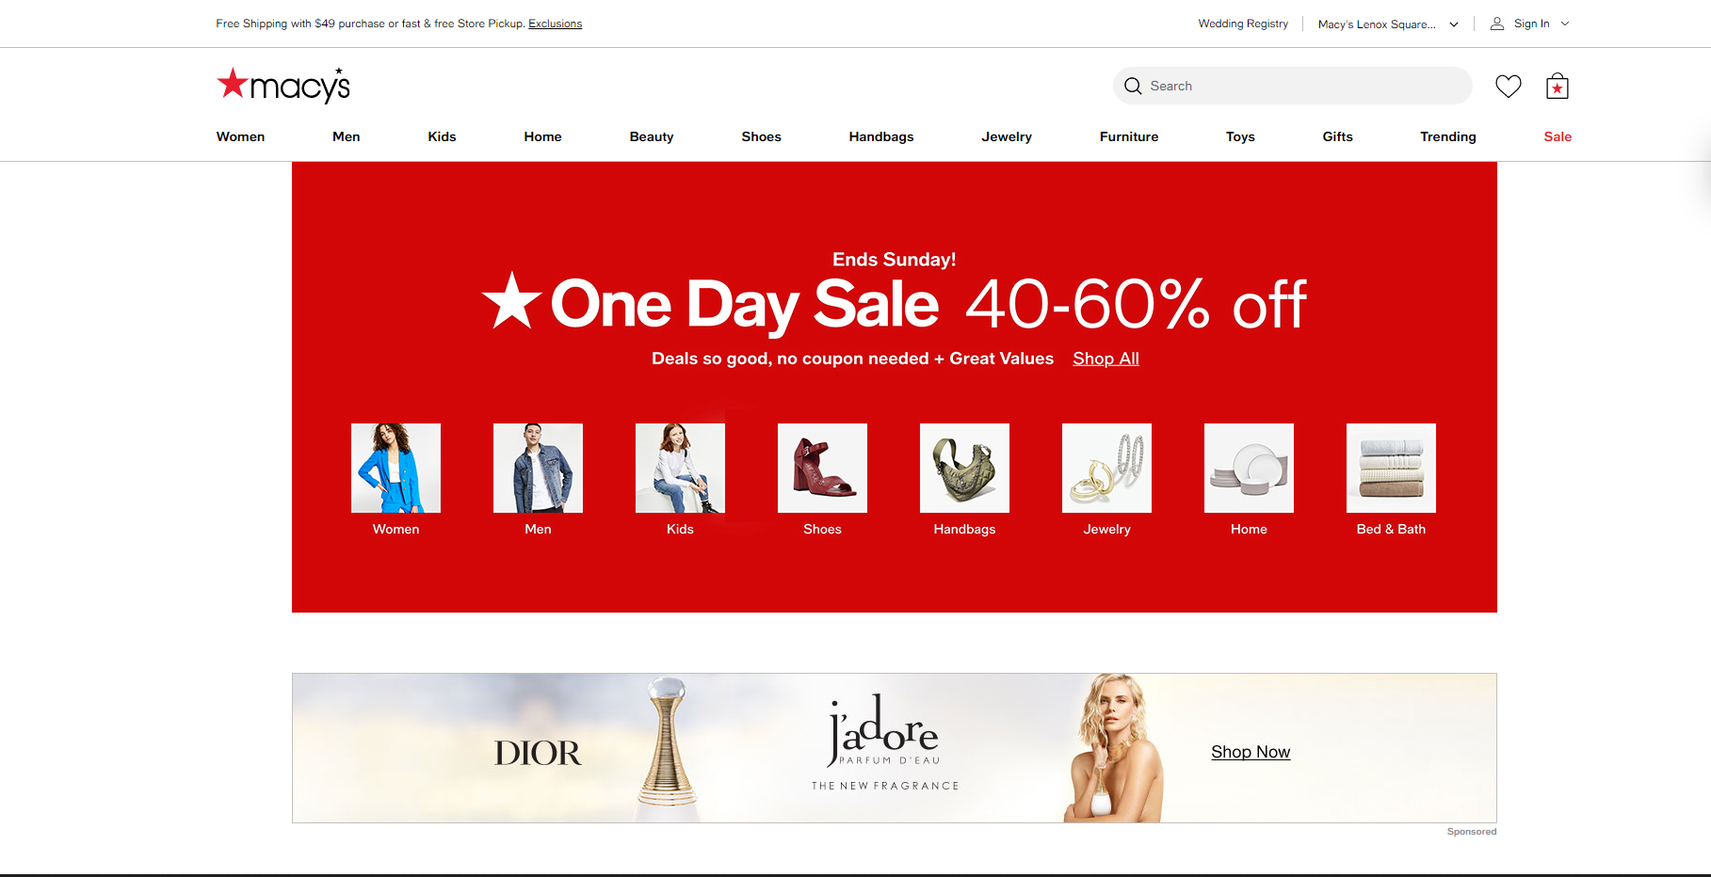
Here’s The Website of a Company Doing $25B in Sales

Slide 37
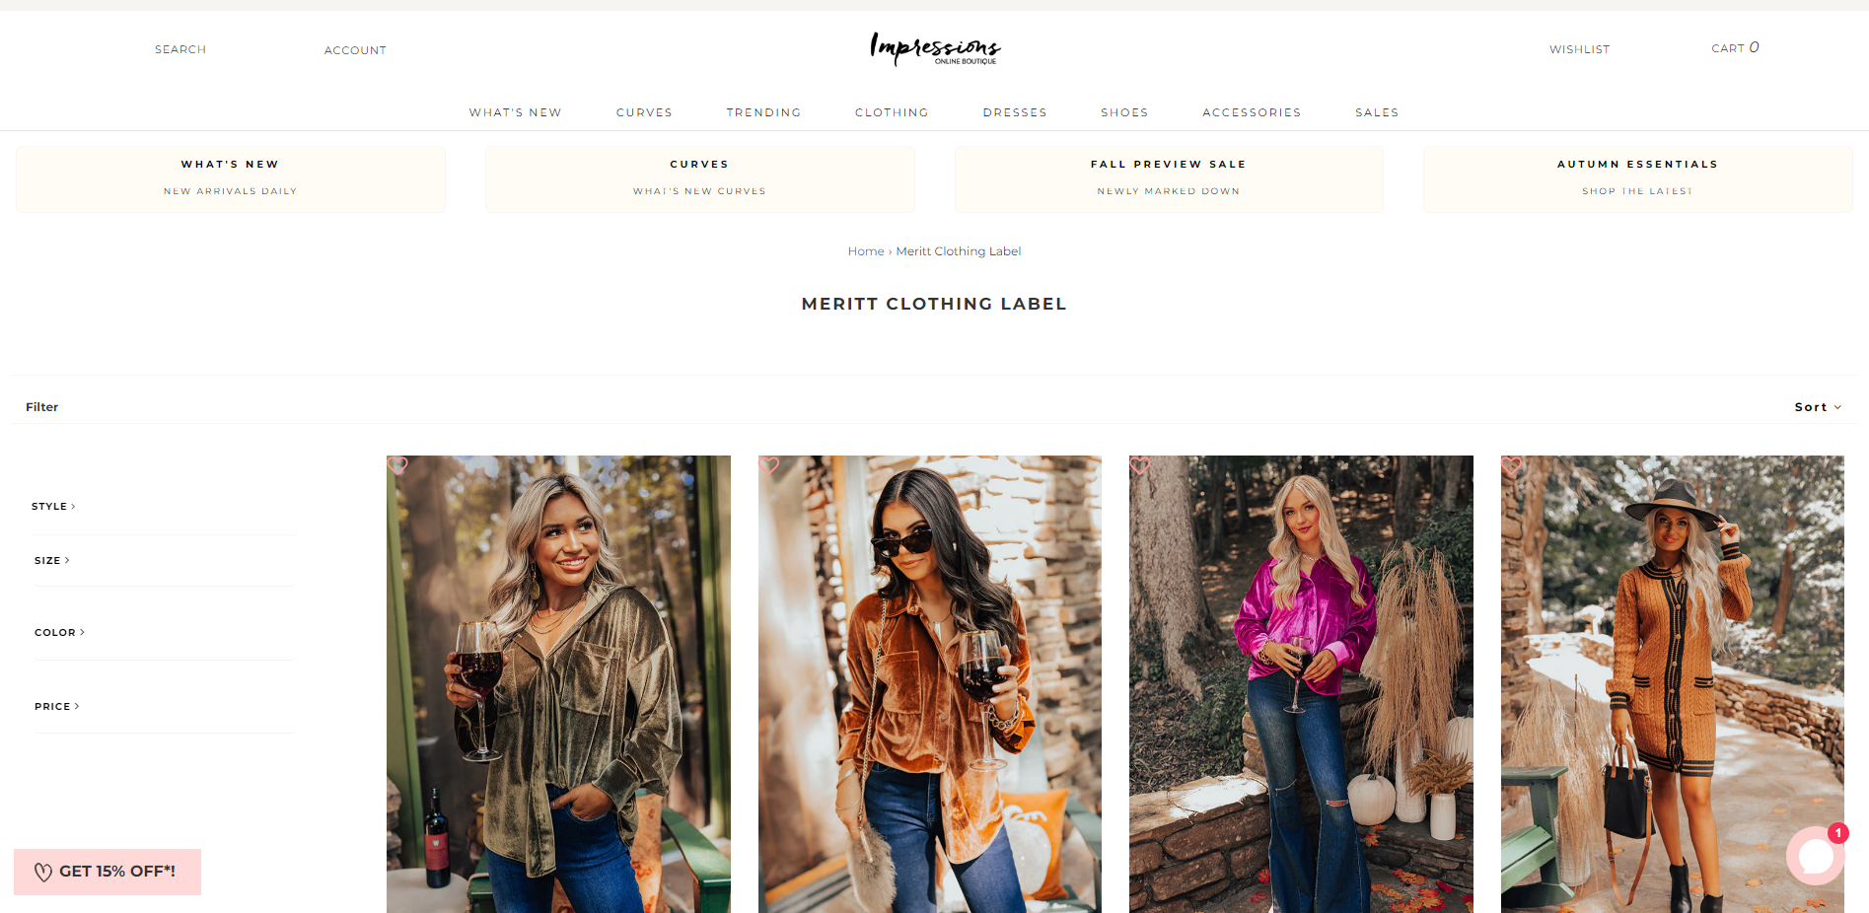
Here’s The Website of a Company Doing $20M In Sales

Slide 38
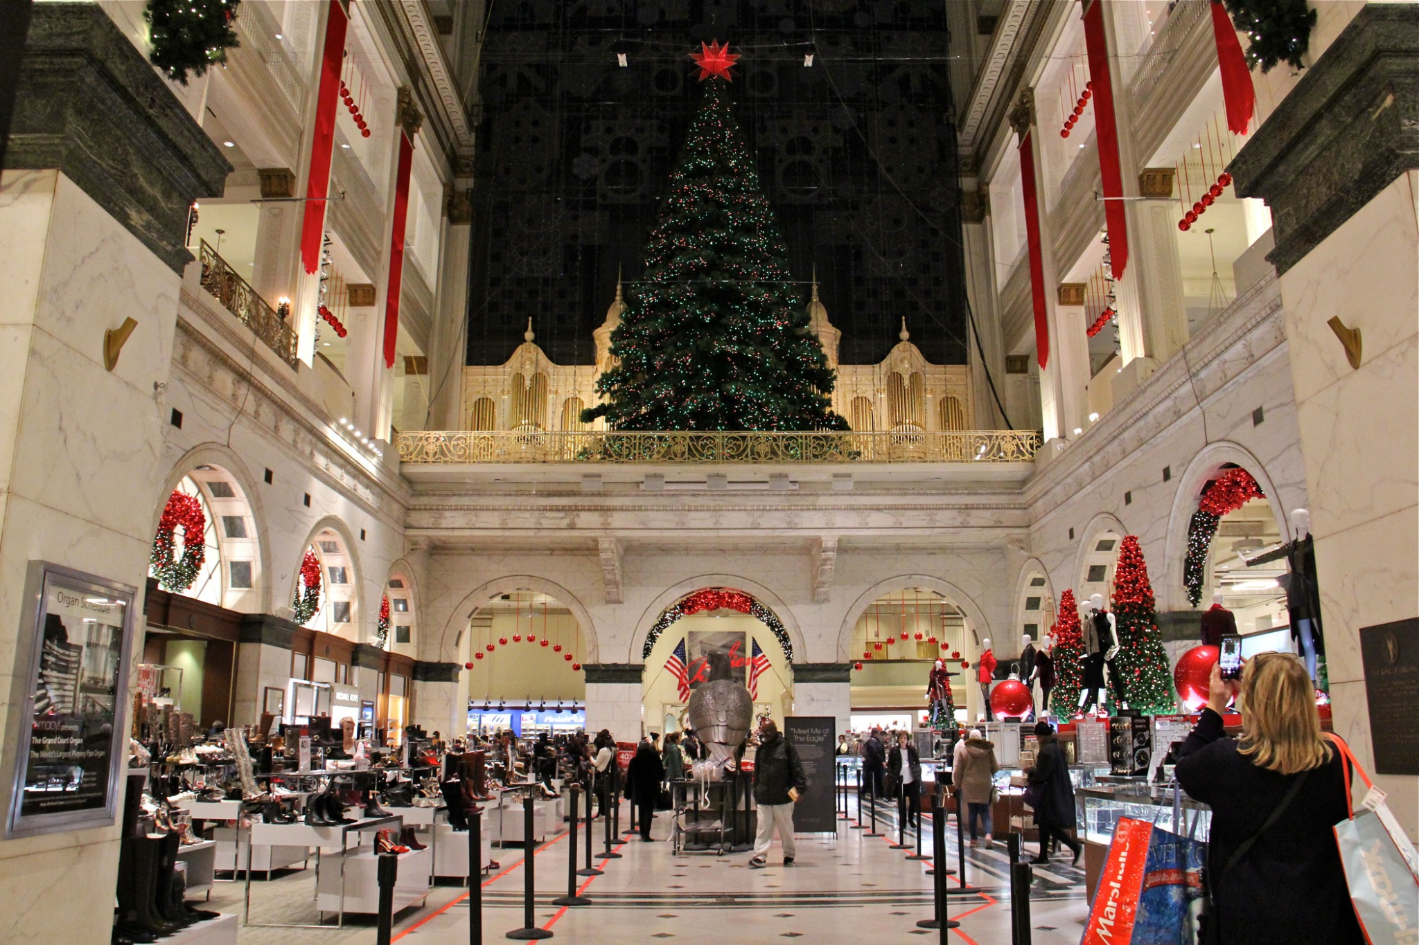
Here Are Those Companies’ Brick & Mortar
Macy’s
Boutique Brand
N/A

Slide 39
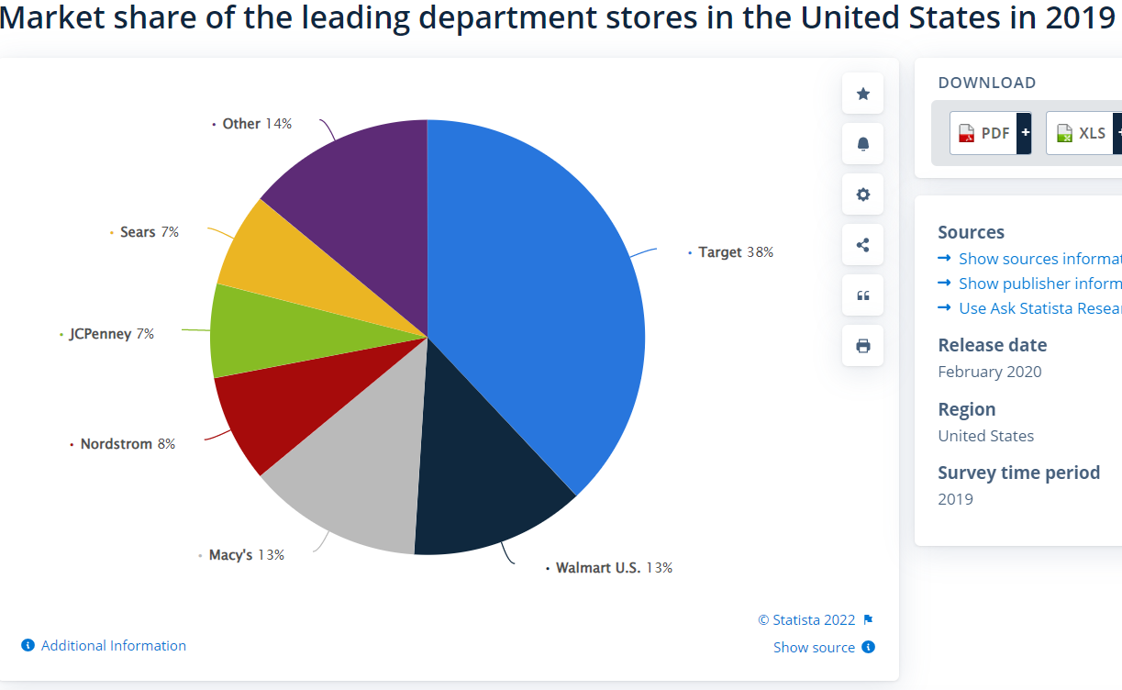
Other 14%
Sears 7%
Walmart 38%
JC Penney 7%
Nordstrom 8%
Macy’s 13%
Target 18%

Slide 40
So Where Does That Leave Us?
Our Recommendation: “Online First”
Revamp Online Presence
Buy Online, Pick-Up In Store
New online media presence
TikTok
Social Selling
Partner w/ Amazon Prime
Turn a Threat To A Strategic Asset
Reduces Costly Value Chain Item
To Summarize The Issue:
E-Commerce Is Continuing To Grow
Macy’s Has Never Been an Industry-Leader in E-Commerce
New Wave of Competitors Inbound

Slide 41
In Summary…
Strategy: Best Cost Strategy
Two-Ends Of The Value Chain
Outdated Brand Image -> Modernize Our Marketing & Brand Image
Aging Demographic -> Partner with Boutique Brands
Lack of Online Presense -> Shift Business Model To ‘Online First’
B&M Business Model Is Dying -> Re-Establish The B&M Business Model

Slide 42
Sources
Slide 4: https://www.fastcompany.com/90777012/toys-r-us-stores-locations-full-list-of-macy-stores-where-the-iconic-toy-retailer-has-reopened
Slide 7: https://www.macysinc.com/investors/sec-filings/annual-reports/content/0001564590-22-011726/0001564590-22-011726.pdf
Slide 7: https://investors.kohls.com/financials-and-filings/sec-filings/sec-filings-details/default.aspx?FilingId=15666560
Slide 7: https://www.annualreports.com/Company/j-c-penney-company-inc
Slide 7: https://press.nordstrom.com/static-files/879478f9-0ee8-4b1e-a66a-3bc0eddc83b0
Slide 13: https://www.foxnews.com/lifestyle/fashion-brands-clothing-retailers-stand-against-injustice-george-floyd-protests
Slide 22: https://www.tampabay.com/news/business/2022/08/23/macys-cuts-outlook-with-inflation-and-inventory-elevated/

